Slide 1

Treasure of Subway Data
Treasure of Subway Data
Saleh Aljomyl
Ghainm Alghainm
7 Oct 2021

Slide 2

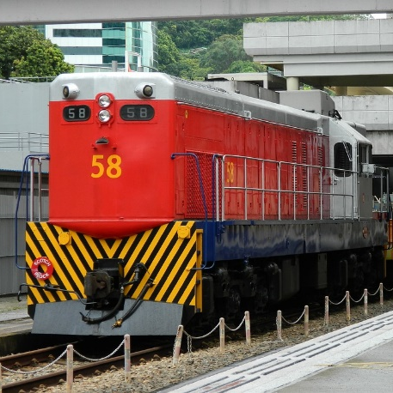
The Main Goals
You have a treasure, and this treasure undiscovered yet. It’s the data of the subway, during this presentation
We will show you how can you improve your investment and increase your seal and in sequences increase your profit by reducing the electricity bill of the Stations

Slide 3

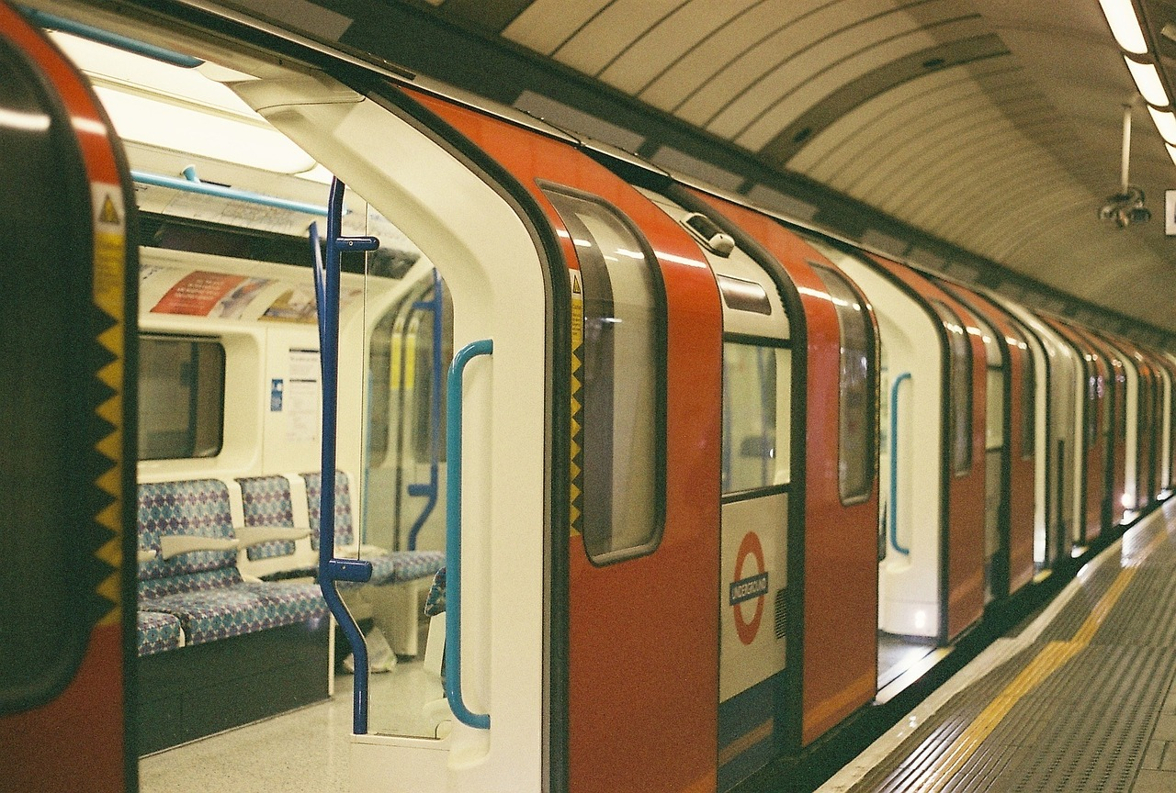
The data that I used for three months starting from 29th of May 2021 until 27th of August 2021 and the total record is :
2,722,610
Records
The Source of data.
All this data from web site : http://web.mta.info/developers/turnstile.html

Slide 4
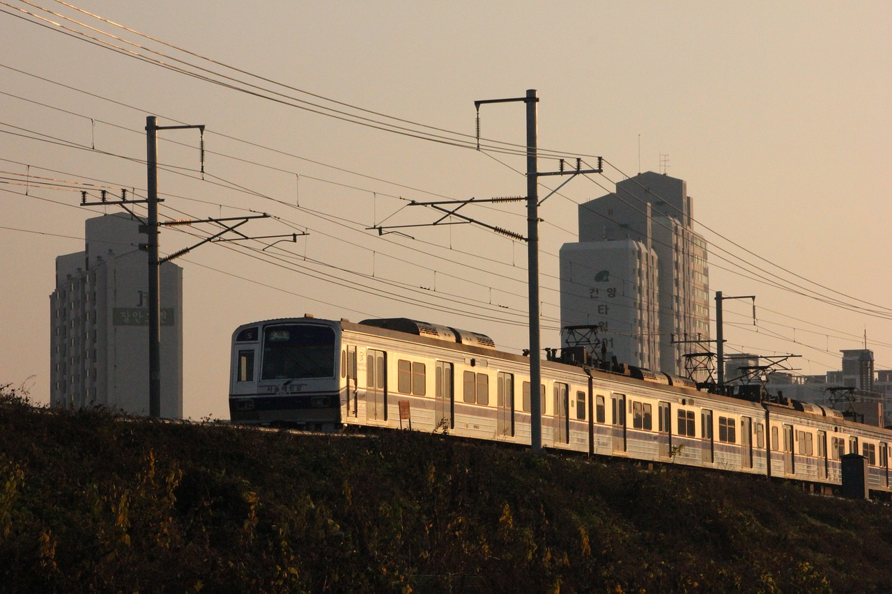

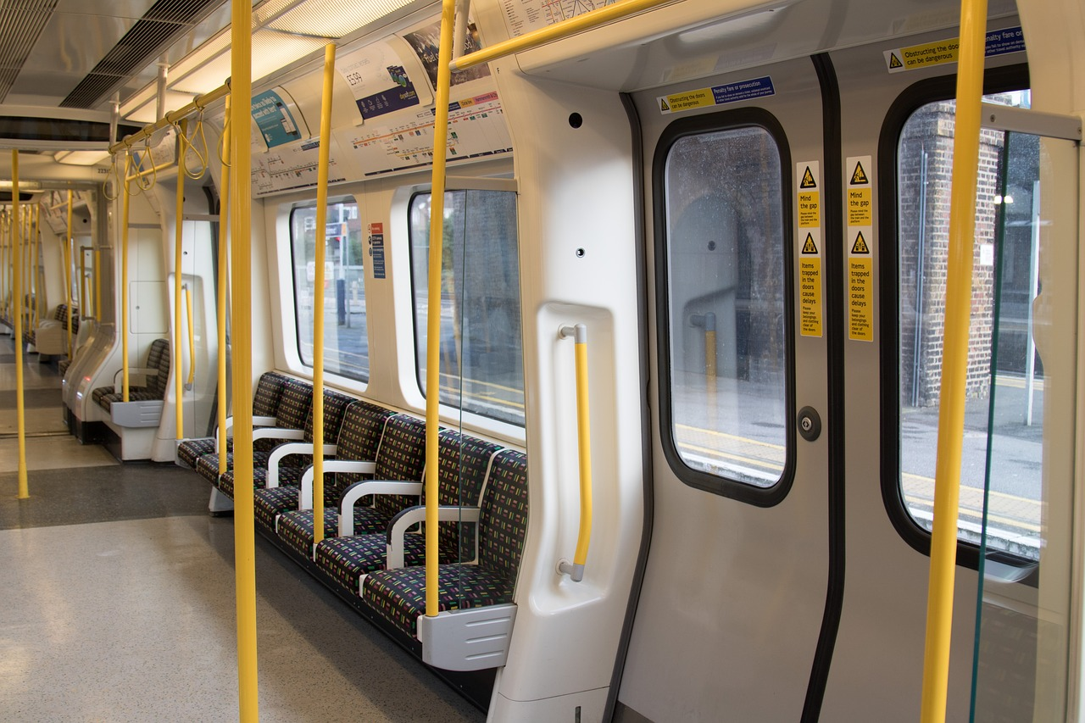
Focus your
business
Advertisements
Electricity
Consultation
Where is the most crowd and based on
What you can put your advertisements
Reducing the electricity bill by finding the suitable number of turnstile for specific station
Where is the most place that people visit?
And how can you aim gathering
By use this data you can discover how can improve the MTA service

Slide 5
Step to Clean The Data
Duplication
Null Value
Fix Column
Add Column
01
02
03
04
The most issue of the data that some of them have duplication because of the recover audit

Slide 6
Step to Clean The Data
Duplication
Null Value
Fix Column
Add Column
01
02
03
04
After calculate the different between the previous Entries and current entries some day have null value

Slide 7
Step to Clean The Data
Duplication
Null Value
Fix Column
Add Column
01
02
03
04
Change the column name like C/A to control area and remove the white space from EXITS column

Slide 8
Step to Clean The Data
Duplication
Null Value
Fix Column
Add Column
01
02
03
04
Add column to add more meaningful for the data

Slide 9
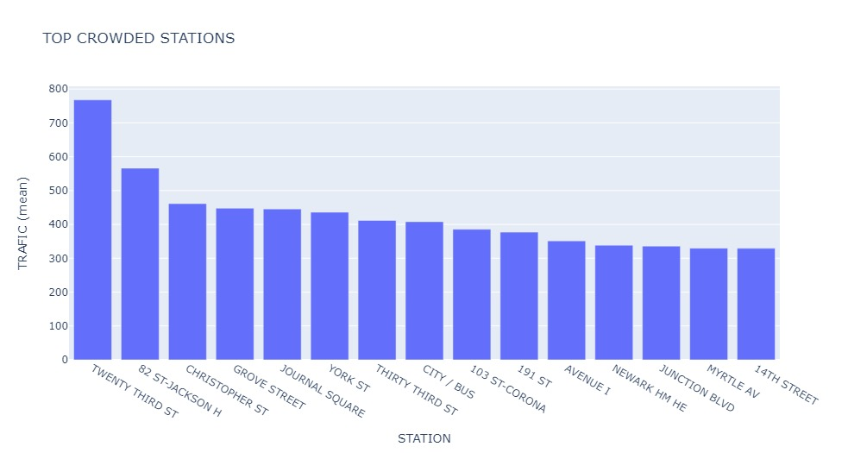
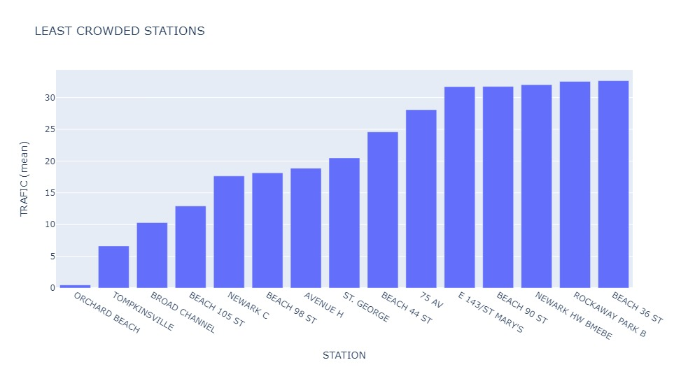
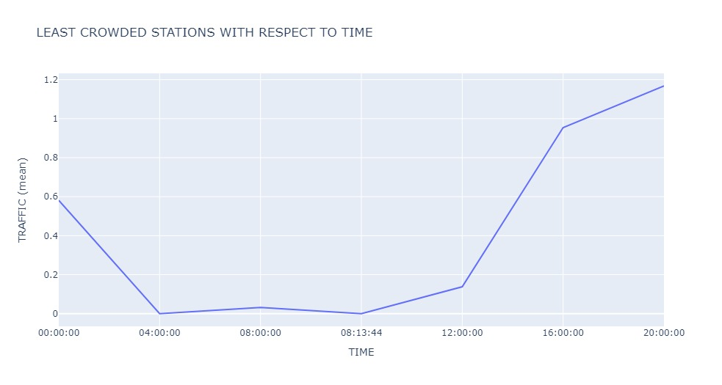

Slide 10
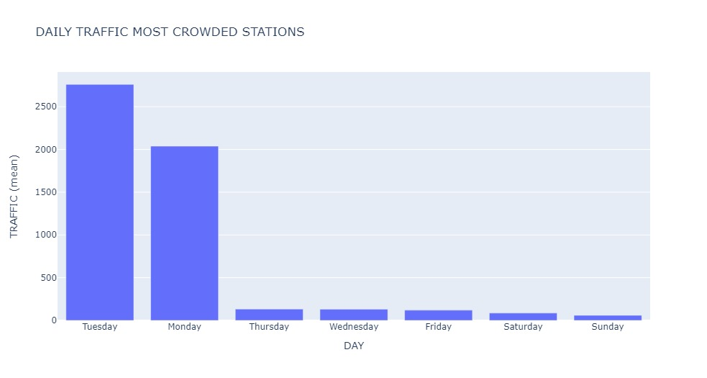
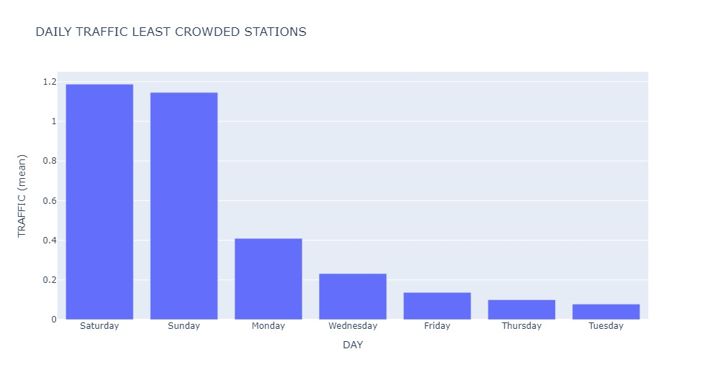

Slide 11




Tools to analyses the data
01
02
03
04
MS Excel
Jupyter
Python
SQLite

Slide 12

1
panda
To store the data and handling the information
2
plotly
To draw chart and visualize the information
3
matplotlib
To draw chart and visualize the information
4
datetime
To handle the date and extract the day name and week number and month name
Packages
5
numpy
To use where and handle the list

Slide 13

“Thank you for listening.

